Slide 1
Implementing automation practices using Azure OpenAI

Slide 2
Deploy app resources
Exercise 1

Slide 3







Exercise 1 Architecture
Contoso Suites Environment
Resource Group
Local Machine
Storage Account
Cosmos DB
Visual Studio Code
Anaconda Python
AI Search
Azure OpenAI
Git
Notes:
Exercise 1 will focus on preparing two separate environments: an Azure resource group containing necessary services, and a local machine with the development resources needed for this training.
You will be given a Bicep script in task 1 that builds out a storage account, Cosmos DB instance, and AI Search service in a resource group you create. Then, in task 3, you will manually create an Azure OpenAI service.
In the meantime, task 2 covers the installation of local tools. We recommend having Visual Studio Code and the Anaconda distribution of Python installed. You can get by with a standard version of Python 3.10 or later, though you may need to install some dependencies separately if you go with a standard Python installation.

Slide 4
Introduction: Deploy app resources
In this lab, you’ll set up a development environment in Azure and on your local machine
After completing this lab, you’ll be able to:
Deploy a Bicep script to build Azure resources
Create an Azure OpenAI Service resource
Install Python and necessary Python packages on a local machine
Notes:
Speaker notes:
In this exercise, you will lay the groundwork for Azure OpenAI integration by deploying out a series of Azure resources and ensuring your local machine has the appropriate software installed.
Learning objectives
After completing this lab, you'll be able to:
Deploy a Bicep script to build Azure resources
Create an Azure OpenAI Service resource
Install Python and necessary Python packages on a local machine

Slide 5
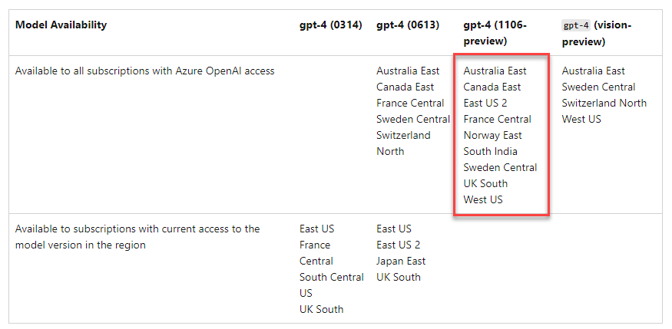
Choose an appropriate region
Notes:
Speaker notes:
You will work with the GPT-4 model in this training. This will limit the number of regions you can use for deployment. Review the region availability table (https://learn.microsoft.com/en-us/azure/ai-services/openai/concepts/models#model-summary-table-and-region-availability) and ensure that you choose a region that supports GPT-4.
Be sure to choose a region from this list! If you do not, you will may have access to the GPT-4 model for your deployments and will need to rely on GPT-3.5.

Slide 6
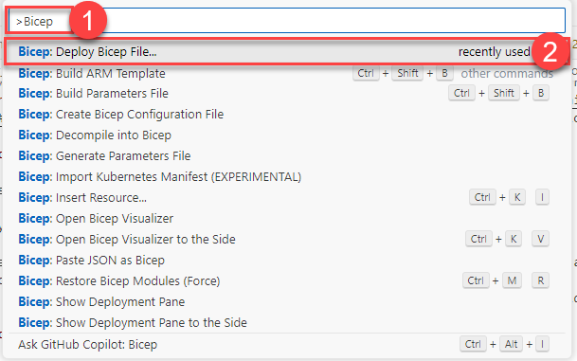
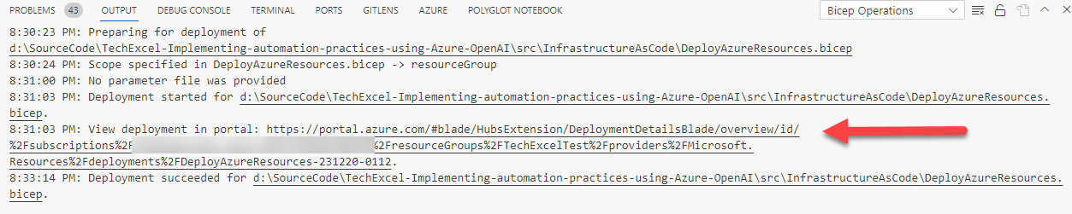
Deploy a Bicep script
Notes:
Speaker notes:
In the first task of this exercise, you will deploy a set of resources to Azure using a Bicep script. One easy way of running a Bicep script is to use the Bicep extension in Visual Studio Code. From there, you can open a Bicep script (file in .bicep format) and deploy it using the Bicep: Deploy Bicep File… command in VS Code. It will ask you for a few pieces of information, such as the deployment name, subscription, resource, group, and parameter file. Then, it will submit the script to Azure and provide you a link to monitor the results of the deployment.

Slide 7
Add chat with data

Slide 8

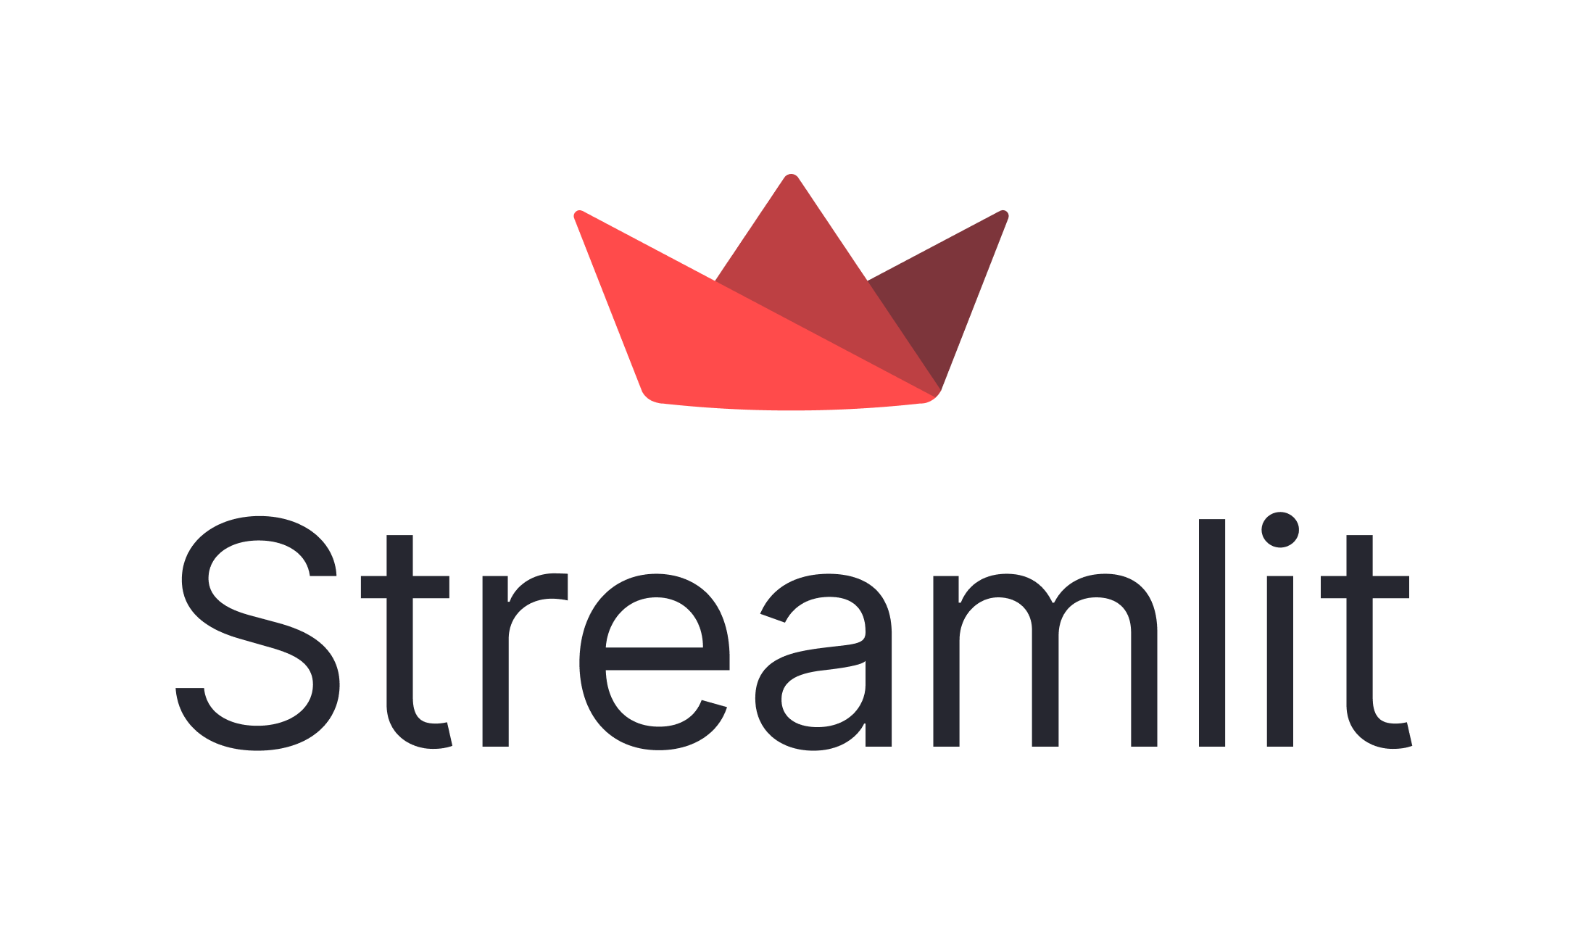
Exercise 2 Architecture
Storage Account
Resorts.txt
AI Search
Hotels.txt
Azure OpenAI
Notes:
This lab will focus around resort and hotel information. You will upload customer data into a storage account and process it using Azure AI Search. From there, you will be able to ask questions of the data in the Azure OpenAI Studio Chat Playground, as well as through the Azure OpenAI API in a Streamlit application.

Slide 9
Introduction: Add chat with data
In this lab, you’ll begin by uploading files into Azure Blob Storage. Then, you will perform data ingestion and vectorization in Azure AI Search. Finally, you will perform chat with data in a Streamlit app.
After completing this lab, you’ll be able to:
Prepare a dataset in Azure Blob Storage for ingestion into Azure OpenAI
Ingest data from Azure Blob Storage into Azure OpenAI via Azure AI Search
Test completions using the Chat Playground in Azure OpenAI
Incorporate chat completions in a Streamlit application
Notes:
Speaker notes:
One of the most natural ways to integrate Azure OpenAI in an existing solution is to incorporate chat into an existing system. For this solution to bring the most value to an organization, however, the chat service must have access to information that may be proprietary or otherwise confidential. In this exercise, we will add custom data to augment an existing Azure OpenAI chat deployment, allowing customer service agents to review customer data in a natural language format.
Learning objectives
After completing this lab, you'll be able to:
Prepare a dataset in Azure Blob Storage for ingestion into Azure OpenAI
Ingest data from Azure Blob Storage into Azure OpenAI via Azure AI Search
Test chat completions using the Chat Playground in Azure OpenAI
Incorporate chat completions into a Streamlit application

Slide 10
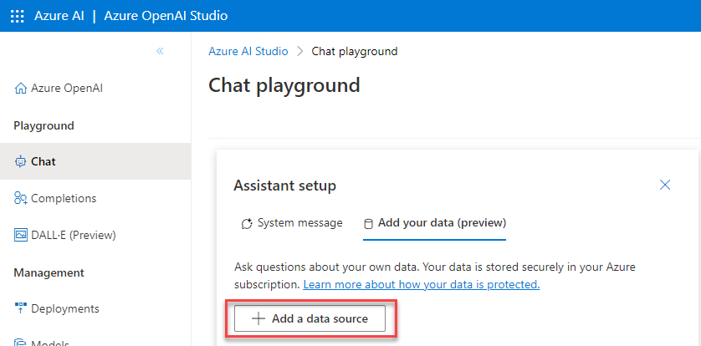
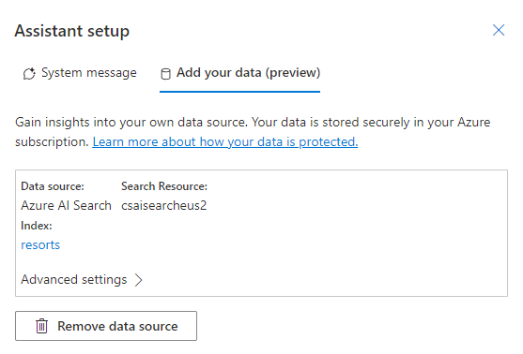
Add Your Data
Notes:
Speaker notes:
The Azure OpenAI Studio makes it easy to import data into Azure AI Search from Azure Blob Storage. From there, you can try chat completions against your data to ensure everything works as expected.

Slide 11
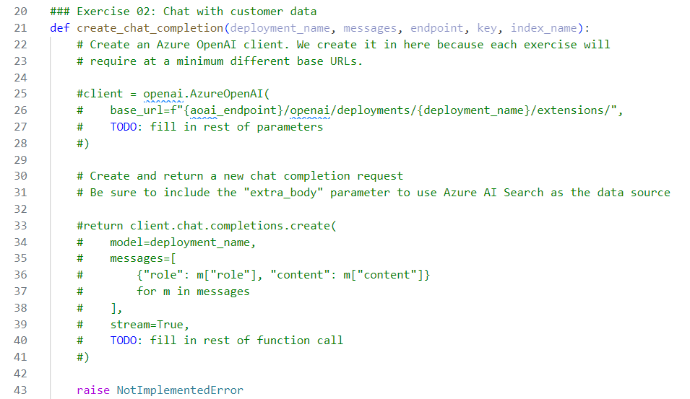
Update a Streamlit Application
Notes:
Speaker notes:
You will fill in the blanks on several existing functions in a Streamlit application.

Slide 12
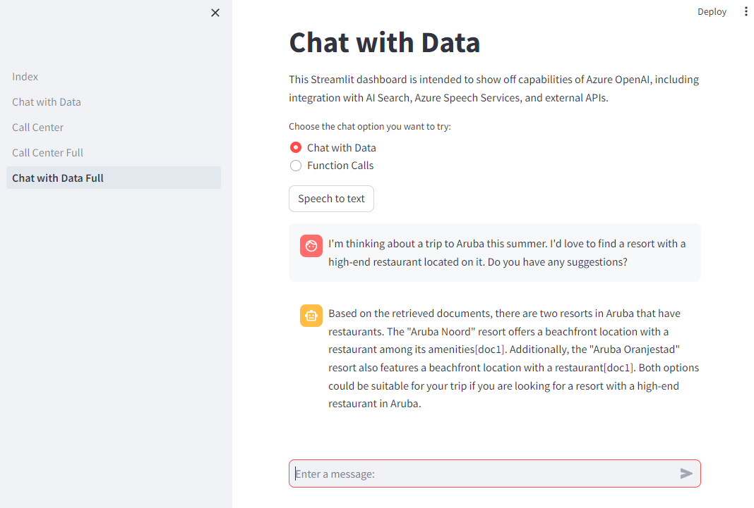
Chat with Data
Notes:
Speaker notes:
The end result is a dashboard that allows direct chat with your customer data.

Slide 13
Implement function calls

Slide 14

Exercise 3 Architecture
Customers.json
Cosmos DB
Azure OpenAI
Web API (C#)
Function definitions
Function call defined
by GPT-4 deployment
Notes:
This exercise will focus on incorporating function definitions and executing function calls with a GPT-4 deployment as the intermediary. You will build an API endpoint in a .NET Web API. This endpoint will retrieve customer data from Cosmos DB based on some filter criteria.
You will make the GPT-4 deployment aware of this function using a function definition. Then, you can use the deployment to automate a function call and bring that data into Streamlit.

Slide 15
Introduction: Implement function calling against external APIs
In this lab, you’ll create a Web API endpoint for customer data. Then, you will build a function definition for the Azure OpenAI service and write Python code in Streamlit to tie everything together.
After completing this lab, you’ll be able to:
Implement a customer account information API endpoint against Cosmos DB using C#
Create a function in Python to perform customer account lookup as part of a broader conversation
Incorporate function calling into the existing chat completions solution
Notes:
Speaker notes:
Bringing our own data is one great way to enhance GPT models in Azure OpenAI, allowing them to answer questions specific to our circumstances. Another way to customize responses and enhance system capabilities involves function calling, a native way for GPT models to formula API calls and structure data outputs based on the functions we specify. In this exercise, you will create a function to supplement chat conversations with customer data.
Learning objectives
After completing this lab, you'll be able to:
Implement a customer account information lookup API endpoint against Cosmos DB using C#
Create a function in Python to perform customer account lookup as part of a broader conversation
Incorporate function calling into the existing chat completions solution

Slide 16
Build a Web API Endpoint
You will build a standard Web API service in C# that reads from data in Cosmos DB.
For the sake of simplicity, this service can run locally or you could deploy it to Azure.
public async Task<IEnumerable<Customer>> GetCustomersByName(string name)
{
var queryable = container.GetItemLinqQueryable<Customer>();
using FeedIterator<Customer> feed = queryable
.Where(c => c.FullName == name)
.ToFeedIterator<Customer>();
return await ExecuteQuery(feed);
}
The method above retrieves any customer whose full name matches the input string.
Notes:
Speaker notes:
A recent addition to Azure OpenAI is the ability to define function calls to external resources. To show this off to Contoso Suites, you will first create a simple Web API in C# and have it access data in Cosmos DB.

Slide 17
Create a Function Definition
You will then tell the Azure OpenAI service about any available functions, including input parameters, data types, and required inputs.
This is an example of a function definition.
functions = [
{
"name": "get_widgets",
"description": "Get widgets by owner",
"parameters": {
"type": "object",
"properties": {
"owner": {"type": "string"},
},
"required": ["owner"],
},
}
]
Notes:
Speaker notes:
Once your Web API service is running, you can define function calls in your Python code. For example, this get_widgets() would call a local function in Streamlit named get_widgets(). That local function could then reference an external API and bring back data.

Slide 18
Implement audio transcription

Slide 19


Exercise 4 Architecture
AI Services Speech
Azure OpenAI
Notes:
This exercise will incorporate speech to text. You will use a microphone to state an utterance and then send that to the AI Services Speech service for recognition. From there, you will submit the text to Azure Open AI for chat completion. You will do this in the Azure OpenAI Studio Chat Playground as well as from a Streamlit application.

Slide 20
Introduction: Implement audio transcription
In this exercise, you’ll create an Azure AI Services Speech service and use it to transcribe utterances from your microphone into chat completion requests in Azure OpenAI.
After completing this lab, you’ll be able to:
Create an Azure AI Services Speech service and test it using the OpenAI Studio Chat playground
Incorporate speech to text into the existing chat completions solution
Notes:
Speaker notes:
To this point, we have shown Contoso Suites some of the benefit of chat completions with the Azure OpenAI service. In this exercise, we will extend from text to include spoken requests as well.
Learning objectives
After completing this lab, you'll be able to:
Create an Azure AI Services Speech service and test it using the OpenAI Studio Chat playground
Incorporate speech to text into the existing chat completions solution

Slide 21
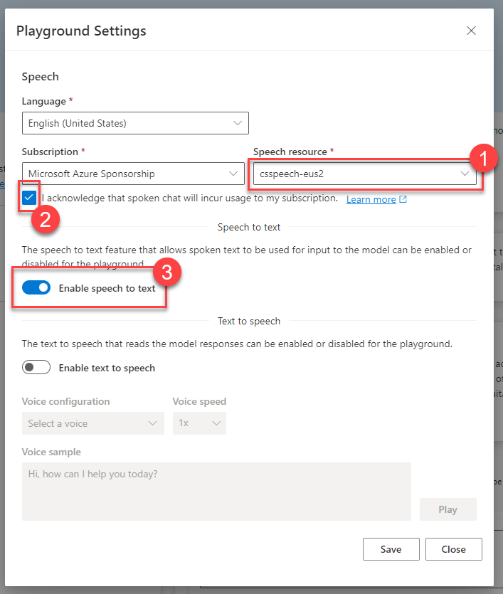
Prepare a speech resource
The Azure OpenAI Studio has built-in support for AI Services Speech resources.
You will work with a speech to text scenario in this exercise, but text to speech is also a possibility.
Notes:
Speaker notes:
The Azure OpenAI Studio has built-in support for AI Services Speech service resources. You will create an AI Services Speech resource in the same region as your Azure OpenAI service and enable speech to text in the OpenAI Studio Chat Playground.

Slide 22
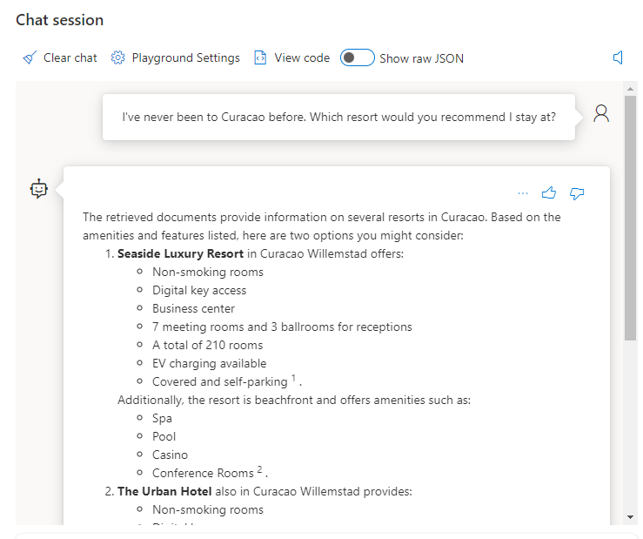
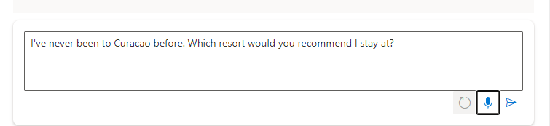
Make Requests using Speech
Notes:
Speaker notes:
When you select the microphone option, you will be able to speak your request. The speech to text service interprets your request as an utterance. You can then send the interpreted message and receive a response as though you typed in the message.
You will implement similar functionality in the Streamlit application as well.

Slide 23
Provide live audio transcription
Exercise 5

Slide 24

Exercise 5 Architecture
AI Services Speech
Azure OpenAI
Notes:
Exercise 5 focuses on audio transcription. You will perform speech-to-text analysis of pre-recorded calls as well as your microphone input. You will then build a simple mechanism to check if a call meets compliance requirements.

Slide 25
Introduction: Provide live audio transcription
In this lab, you will enable users to upload audio files or stream input from their microphone. The audio will go through the AI Services Speech service, which will transform that audio to text. You will also implement a simple form of compliance checking on the audio to ensure it meets policy requirements for Contoso Suites.
After completing this lab, you’ll be able to:
Configure branching in GitHub
Setup protected branches
Setup a GitHub security policy
Configure code security and vulnerability scanning
Create app monitoring dashboards
Configure app availability monitoring
Notes:
Speaker notes:
In the prior exercise, you captured an utterance and submitted it to the Azure AI Services Speech service for speech to text transcription. From there, you submitted that text as an input to a chat client.
In this exercise, you will enable users to upload audio files or stream input from their microphone. The audio will go through the AI Services Speech service, which will transform that audio to text. You will also implement a simple form of compliance checking on the audio to ensure it meets policy requirements for Contoso Suites.
Learning objectives
After completing this lab, you'll be able to:
Incorporate audio file upload and audio transcription into a Streamlit app
Incorporate live microphone transcription of a full audio stream into a Streamlit app
Check whether a call meets compliance requirements

Slide 26
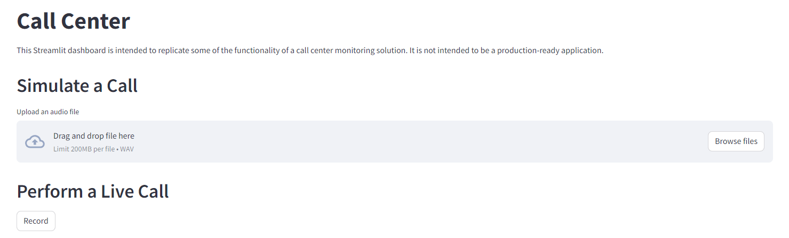
Call Simulation
Use the st.file_uploader() widget in Streamlit to accept file uploads, or use a button to perform call recording.
Notes:
Speaker notes:
Streamlit has a built-in capability for file uploads, using the st.file_uploader() widget. You will use this to capture an audio file in WAV format and submit it to the AI Services Speech service for transcription.
You will also use a Streamlit Extras stateful button to perform live call recording, enabling you to speak into a microphone and stream that data to Azure AI Services for transcription.

Slide 27
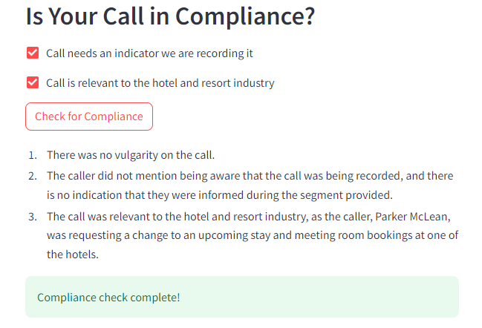
Call compliance
You will build a simple set of compliance checks for Contoso Suites.
In this procedure, you will create checks regarding:
Whether the call transcript contains vulgarity
Whether the call has an indicator that we are recording it for training or quality assurance purposes (optional)
Whether the call is relevant to Contoso Suites: if it is related to the hotel and resort industry (optional)
Notes:
Speaker notes:
You will implement a simple set of compliance checks for Contoso Suites. One of the three checks, whether the call transcript contains vulgarity, will be mandatory. The other two are optional. The first optional check is whether the call has an indicator that we are recording it for training or quality assurance purposes. This is usually a statement you may hear when calling a support line and it serves as affirmation that both parties accept that this call may be recorded. Depending upon the jurisdiction of the callers, this may be legally required in order to record a call.
The other optional check is whether the call is relevant to Contoso Suites inasmuch as it pertains to the hotel and resort industry.

Slide 28
Generate a call summary
Exercise 6

Slide 29


Exercise 6 Architecture
Summarization
Extractive & Abstractive Summarization with Azure AI Language
Query-based Summarization
with Azure OpenAI
Azure AI
Language
Azure OpenAI
Named Entity Extraction
Sentiment Analysis & Opinion Mining
Azure AI
Language
Azure AI
Speech
Call transcription
Notes:
Exercise 6 focuses on using generative AI to summarize text and to extract insights. You will use Azure AI Services and Azure OpenAI to generate summaries of a call transcript, using three different summarization methods (extractive, abstractive, and query-based), and then evaluate the output of each method. You will then use the Azure AI Language service to extract various insights from the call transcript, include assessing the sentiment of the call, performing opinion mining, and extracting named entities.

Slide 30
Introduction: Use Azure AI Services to generate call summaries and extract insights
In this lab, you will expand on the audio transcription work you did in lab 05, focusing on using Azure AI Services--including Azure OpenAI--to summarize the call's transcript and to extract insights from the transcript. You will also preform sentiment analysis and opinion mining.
After completing this lab, you’ll be able to:
Generate summaries using various methods available in Azure AI Services and Azure OpenAI
Use Azure AI Language to extract named entities
Leverage Azure AI Language to perform sentiment analysis and opinion mining
Incorporate call summarization into a Streamlit app
Notes:
Speaker notes:
Now that you have assisted Contoso Suites with automating the creation of audio transcriptions, they would like to leverage Azure AI Services to automate the generation of a call summary, eliminating the need for their customer service agents to do this manually at the end of each call.
In this lab, you will expand on the audio transcription work you did in Lab 05, focusing on using Azure AI Services--including Azure OpenAI--to summarize the call's transcript and to extract insights from the transcript. You will also preform sentiment analysis and opinion mining.
Learning objectives
After completing this lab, you'll be able to:
Generate summaries using various methods available in Azure AI Services and Azure OpenAI. Summarization methods include extractive, abstractive, and query-based summaries.
Use Azure AI Services to extract named entities
Leverage Azure AI Services to perform sentiment analysis and opinion mining
Incorporate call summarization into a Streamlit app

Slide 31
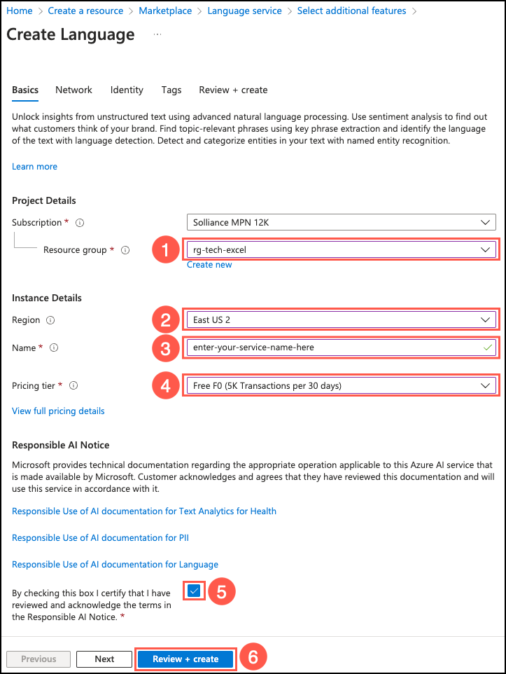
Prepare a language resource
The Azure AI Language service provides numerous capabilities for extracting information and insights from text.
You will use the Language service to summarize text, extract named entities, and perform sentiment analysis and opinion mining.
Notes:
Speaker notes:
You will create an AI Services Language resource in the same region as your Azure OpenAI service to allow for working with different methods of text summarization. You will also use the service to extract named entities and perform sentiment analysis and opinion mining.

Slide 32
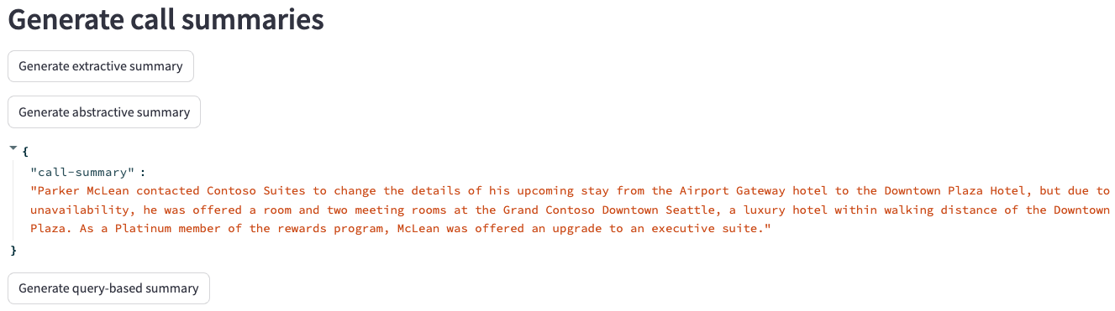
Call Summarization
Using Azure AI Language service, you will generate extractive and abstractive summaries of a call transcript. Using Azure OpenAI, you will create a query-based summary.
Notes:
Speaker notes:
Text summarization is designed to shorten content that users consider too long to read. AI-based summarization focuses on highlighting the most important aspects of the text. Azure AI Services provide several mechanism for summarizing text. The Language service provides extractive and abstractive summarization functions, both of which condense text or documents into key sentences.
- Extractive summarization: Creates a summary by extracting sentences that collectively represent the most important or relevant information within the original content.
- Abstractive summarization: Produces a summary by generating summarized sentences from the document that capture the main idea.
- Query-based summarization: Uses generative AI to create a summary based on the key ideas within text.
For the query-based summarization, you will provide the model with the natural language instructions it requires to identify the task you want it to perform, using a process known as prompt engineering.

Slide 33
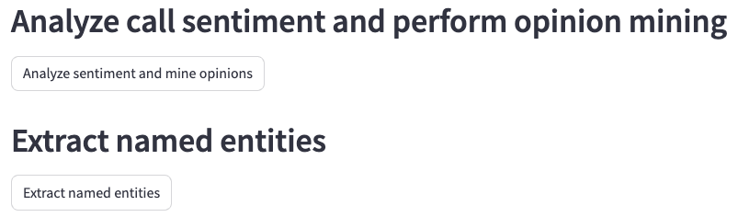
Extract insights
You will use features of Azure AI Language to extract insights from a call transcript.
In this task, you will extract insights using the Azure AI Language service:
Analyze sentiment of the call
Mine opinions
Extract named entities
Notes:
Speaker notes:
Azure AI Language is a cloud-based service that provides Natural Language Processing (NLP) features for understanding and analyzing text. In the last task, you used the Azure AI Language service for text summarization. You will take the analysis at step further in this task, extracting named entities and performing sentiment analysis and opinion mining over the same call transcript.
- Sentiment analysis and opinion mining are features that help you assess what people think of your brand or topic by mining text for clues about positive or negative sentiment and can associate them with specific aspects of the text.
- Named entity recognition (NER) categorizes entities (words or phrases) in unstructured text across several predefined category groups. For example: people, events, places, and dates.
In this task, you will leverage your Azure AI Language service to extract insights from a call transcript. You will start by analyzing the sentiment of the transcript and performing opinion mining against the text. You will then extract named entities from the transcript.

